Slide 1

Managing Data
All the value of this company is in its people. If you burned down all our plants, and we just kept our people and our information files, we should soon be as strong as ever.
Thomas Watson, Jr. Former chairman of IBM

Slide 2
Individual data management
Internal memory is limited
External memory extends internal memory

Slide 3
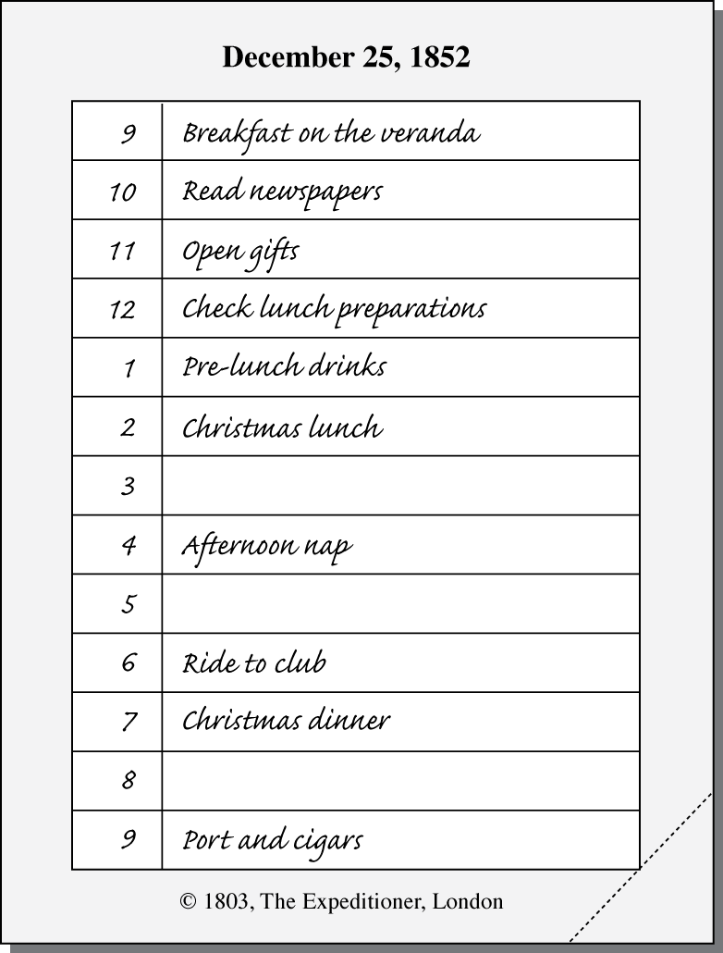
Calendar
Organizing principles
  Set amount of space
  Ordering
  Rapid access

Slide 4
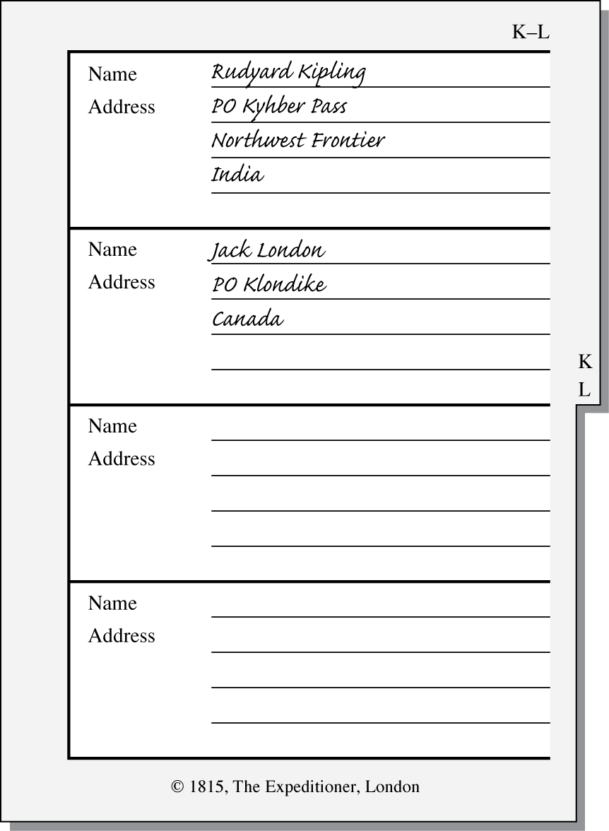
Address book
Organizing principles
  Pre-formatted storage space
  Ordering
  Rapid access

Slide 5
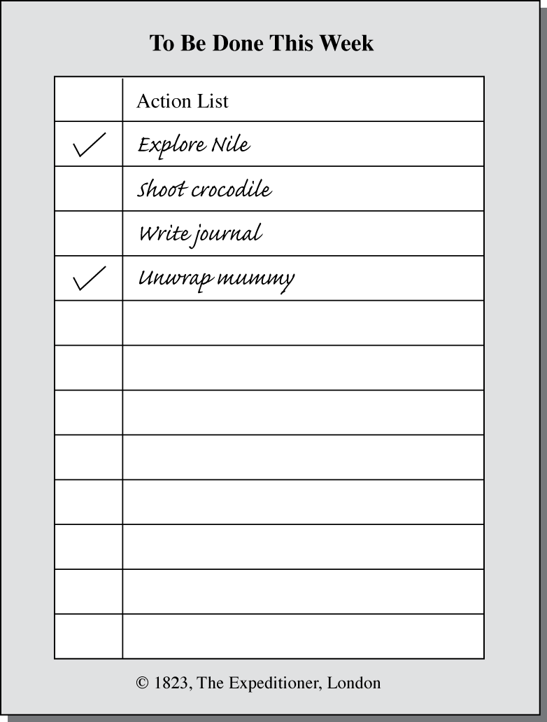
To do list
Organizing principles
  Structure
  Rapid scan support

Slide 6
Comparison of data management systems
Internal
  Small
  Fast
  Convenient
External
  Large
  Slow
  Not as convenient

Slide 7
Organizational data management
Organizations, like people need to remember things
Deciding where and how to store data frequently involves a trade-off
Organizational data is used by a variety of information systems

Slide 8
Types of information systems
Type of IS | System's purpose
TPS | Transaction processing system: Collects and stores data from routine transactions
MIS | Management information system: Converts data from a TPS into information for planning, controlling, and managing an organization
DSS | Decision support system: Supports managerial decision making by providing models for processing and analysing data
EIS | Executive information system: Provides senior management with information necessary to monitor organizational performance, and develop and implement strategies
OLAP | Online analytical processing: Presents a multidimensional, logical view of data
Data mining | Uses statistical analysis and artificial intelligence techniques to identify hidden relationships in data
BI | Business intelligence: Systems for gathering, storing, analyzing, and accessing data to improve decision-making

Slide 9
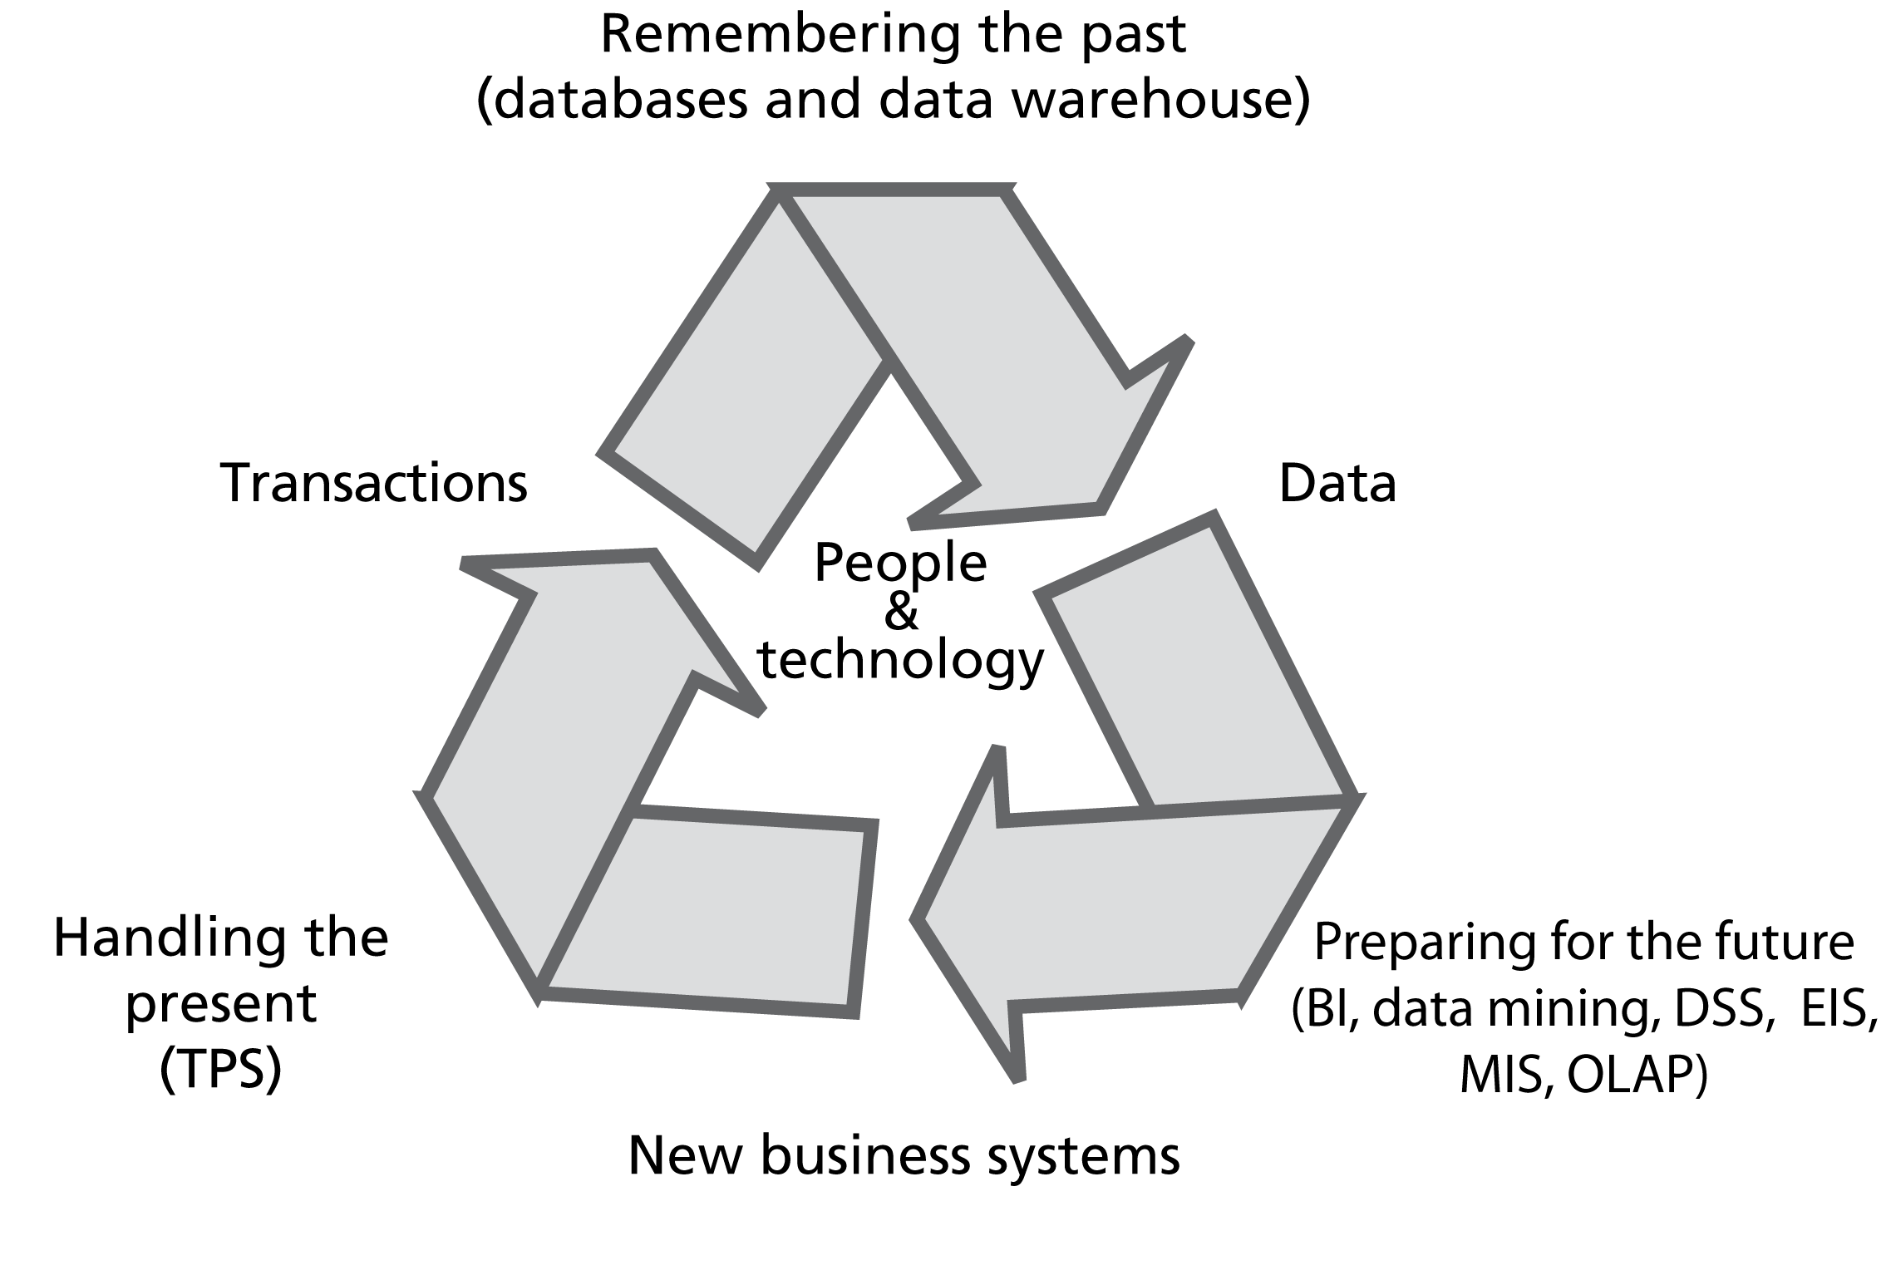
The information systems cycle

Slide 10
Attributes of a data management system
Shareable
Transportable
Secure
Accurate
Timely
Relevant

Slide 11
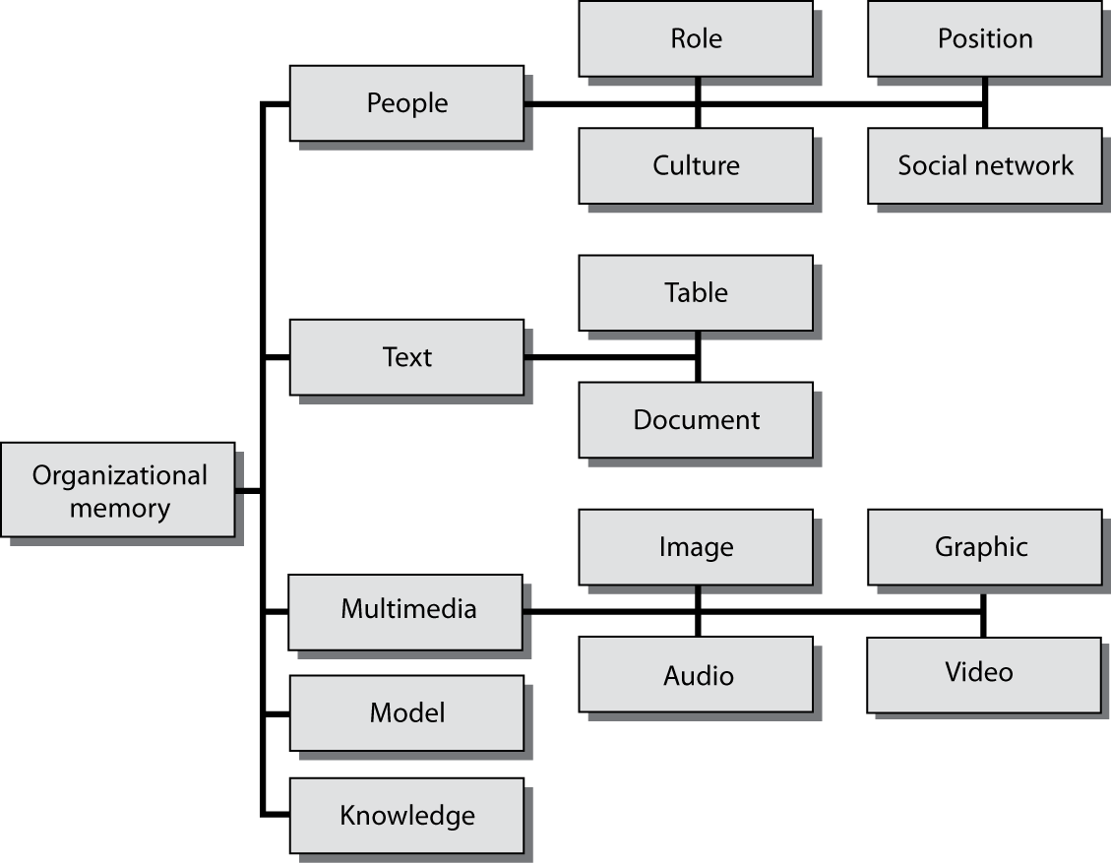
Components of organizational memory

Slide 12
People
The linchpin
  Create, maintain, evolve, and use organizational memory
Role and position
Organizational culture
Social networks
Standard operating procedures

Slide 13
Tables
Product | Price
Pocket knife - Nile | 4.50
Compass | 10.00
Geo positioning system | 500.00
Map measure | 4.90

Slide 14
Documents
Reports
Manuals
Brochures
Memos
Word processing files
Hypertext

Slide 15
Multimedia
Images
Graphics
Audio
Video

Slide 16
Models
Decision support systems
  Mathematical models
  Spreadsheets

Slide 17
Knowledge
Expert systems
Rules

Slide 18
Decisions
Decision making is the central activity of modern organizations
Minutes of a meeting
  Usually not an audit trail of decisions
Reusable decisions
  Take advantage of past deliberations

Slide 19
Specialized memories
Smells
Colors

Slide 20
External memories
External to the organization
Information services

Slide 21
Problems with data management systems
Redundancy
Lack of data control
Poor interface
Delays
Lack of reality
Lack of data integration

Slide 22
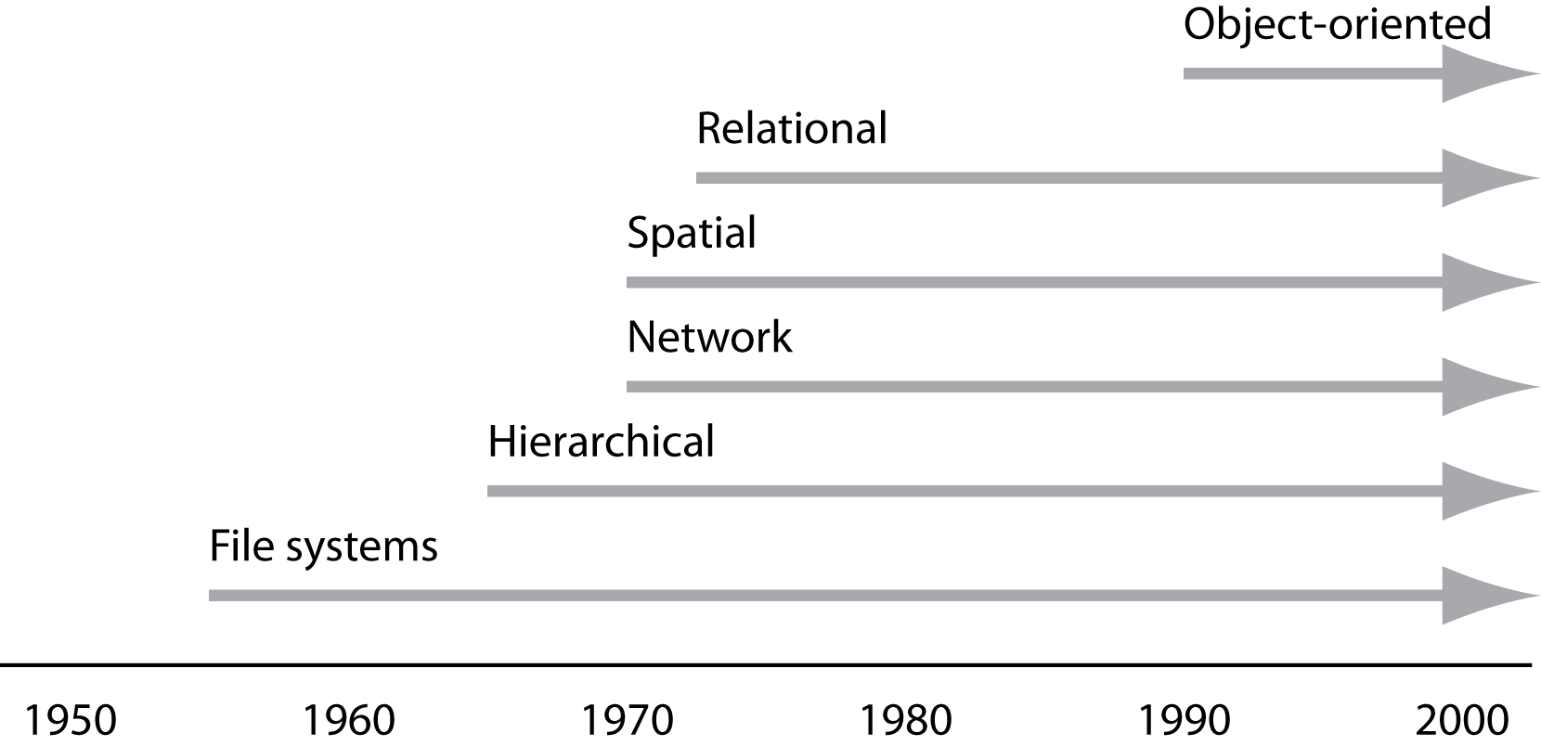
Data management systems timeline

Slide 23
Data, information & knowledge
Data
  Raw, unsummarized, and unanalyzed facts
Information
  Data processed into a meaningful form
  One person's information can be another's data
Knowledge
  Knowing what information is required
  Knowing what the information means

Slide 24
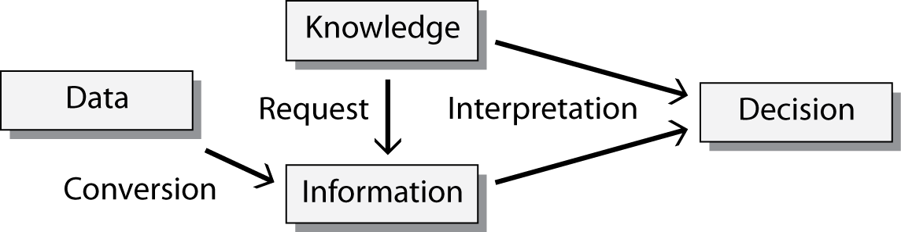
Data, information & knowledge

Slide 25
The challenge
Organizations that effectively use data, information, and knowledge are more successful
The challenge is to develop data management and exploitation skills across an organization
Many organizations do not make effective use of the data they already have
Data management is an enduring problem for nearly all organizations and societies

